Slide 1
The influence of soil depth and grazing practices on the quantity and quality of soil carbon in semi-arid rangelands
S. Emily Grams
Mentors: Nancy Johnson, Ph.D. and Megan Deane McKenna
Northern Arizona University

Slide 2
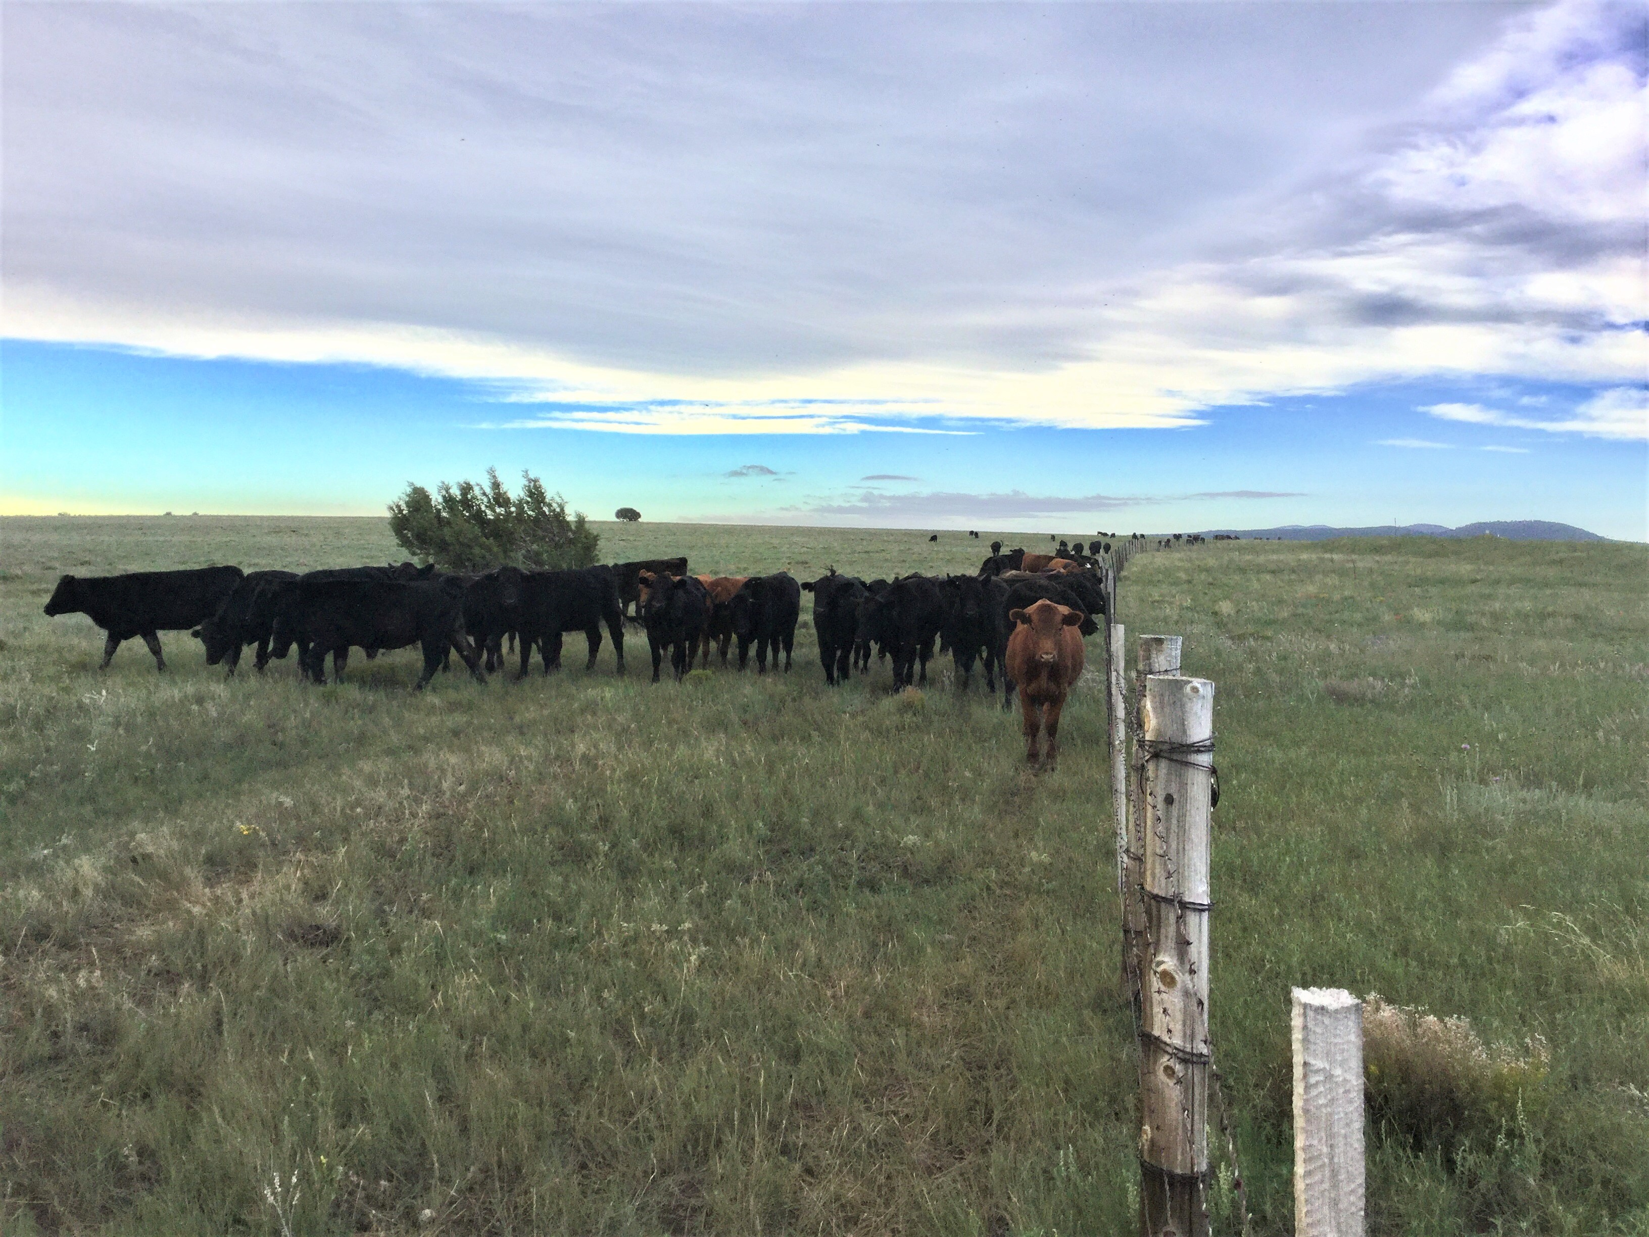
Soil carbon, why is it important and what did we want to know?
It holds a lot of carbon
Climate change
People love meat
What impact do cows have?
Can soil hold more CO2 at greater depths?

Slide 3
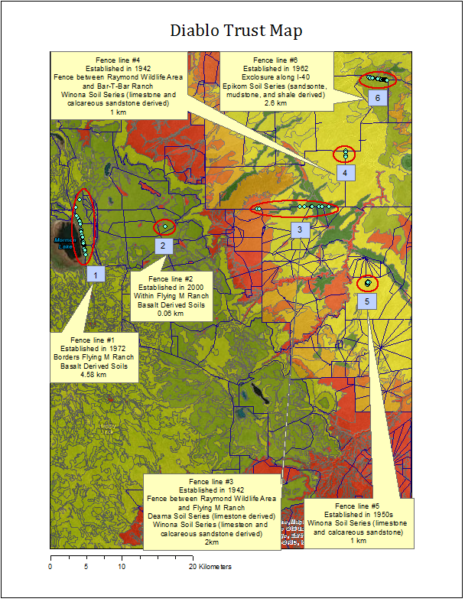
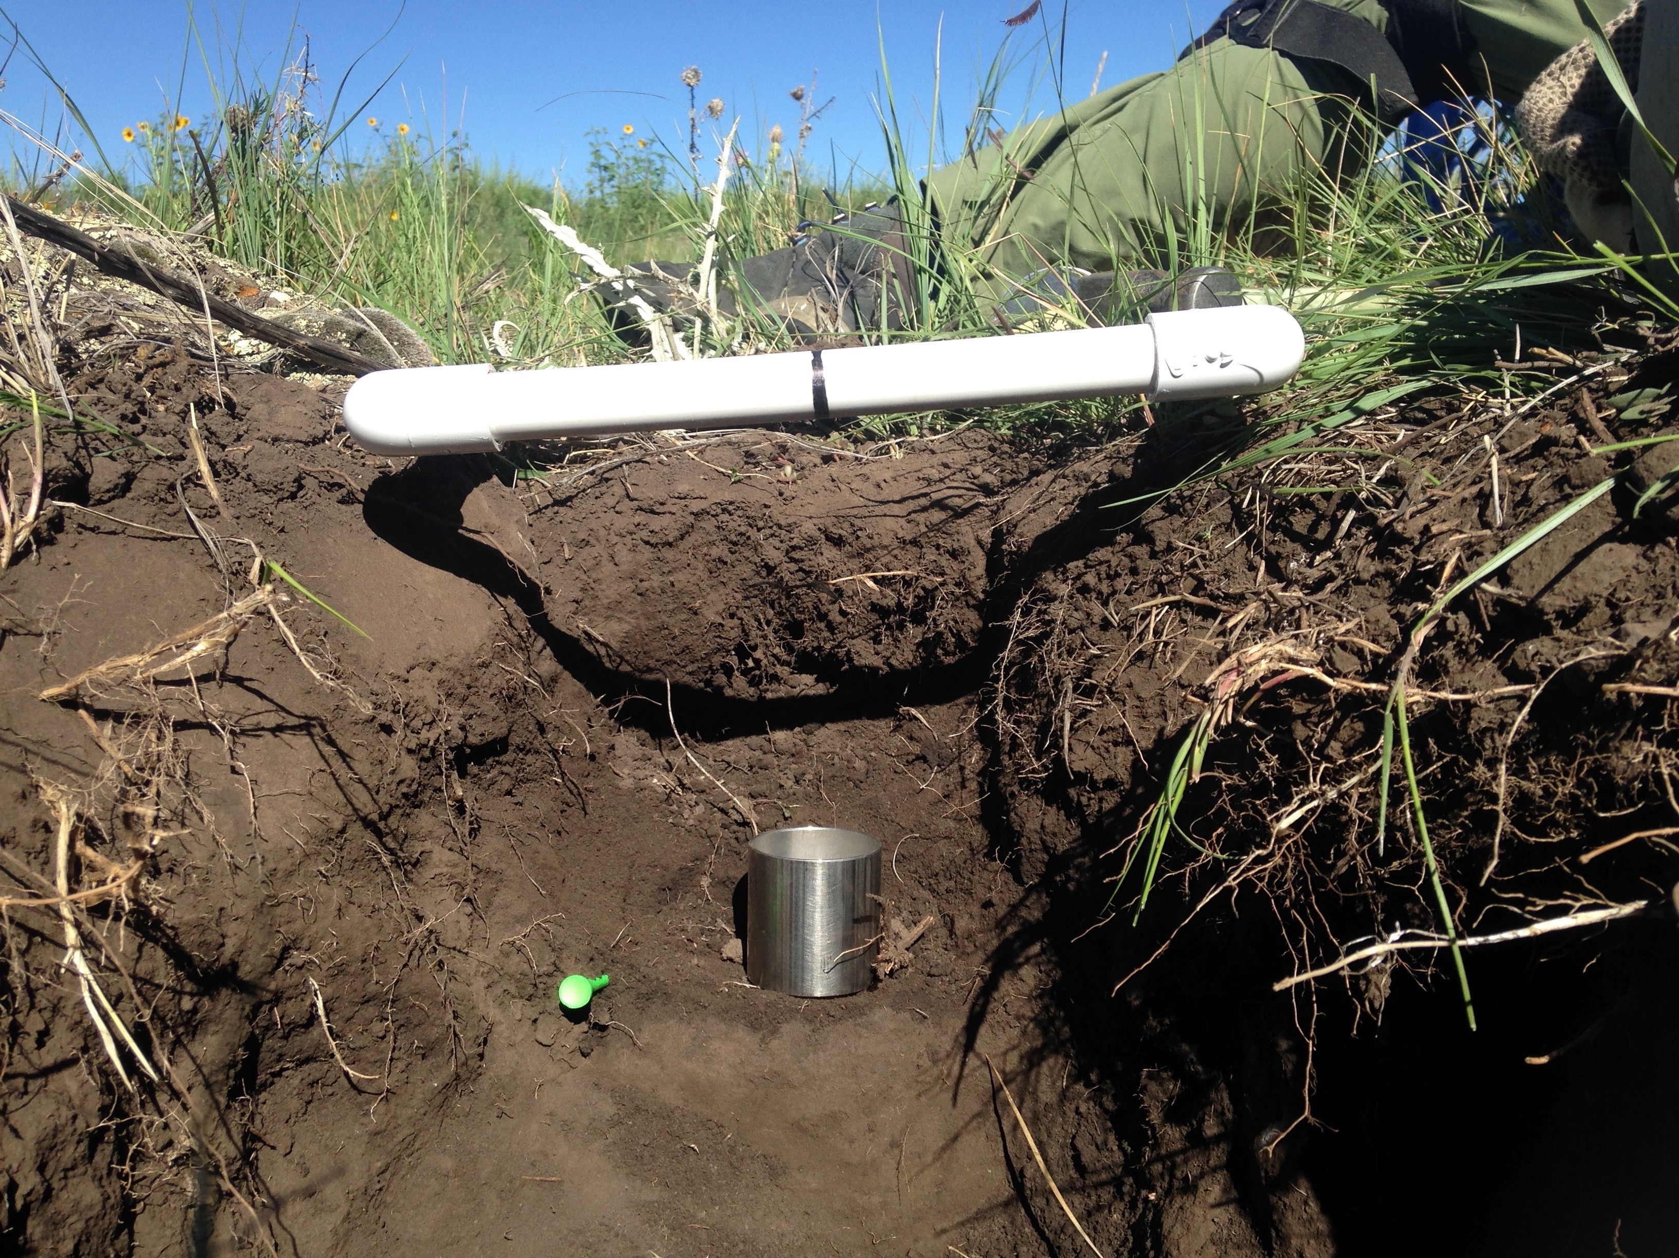
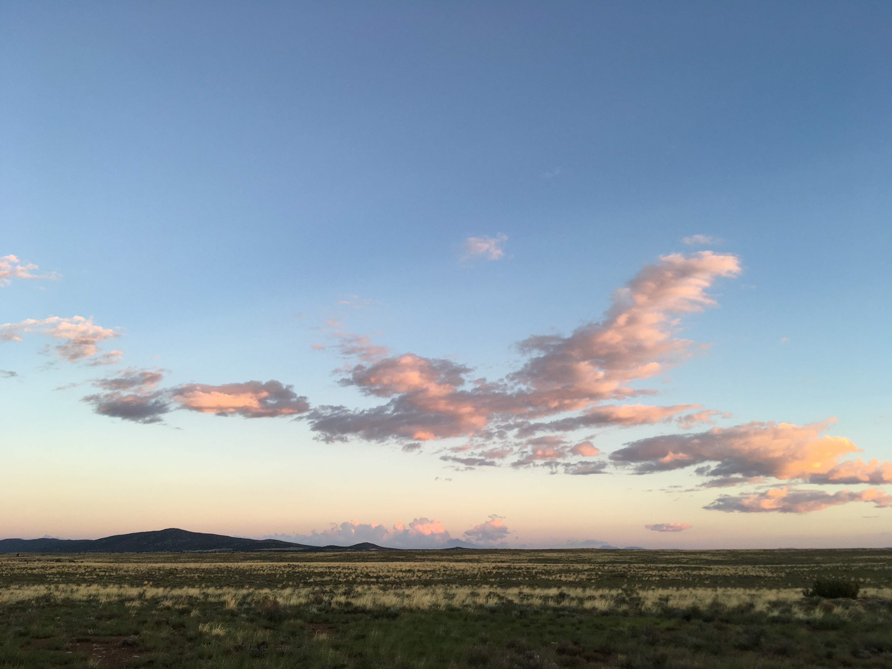
Soil, where did we get it?
August of 2017 from Diablo Trust Ranches in Northern Arizona
0-5cm and 20-25cm, with and without cows, across a variety of soil types
Notes:
After collecting the soil samples multiple processes were used to separate out the roots and rocks, so that the true amount of soil could be determined. Then the soil was burned at different temperatures to determine the amounts or organic and inorganic carbon in the soil.

Slide 4
Soil, what did analysis show?
Clay Soils
Sandy Soils

Slide 5
Continued… Soil inorganic carbon
Clay Soils
Sandy Soils

Slide 6
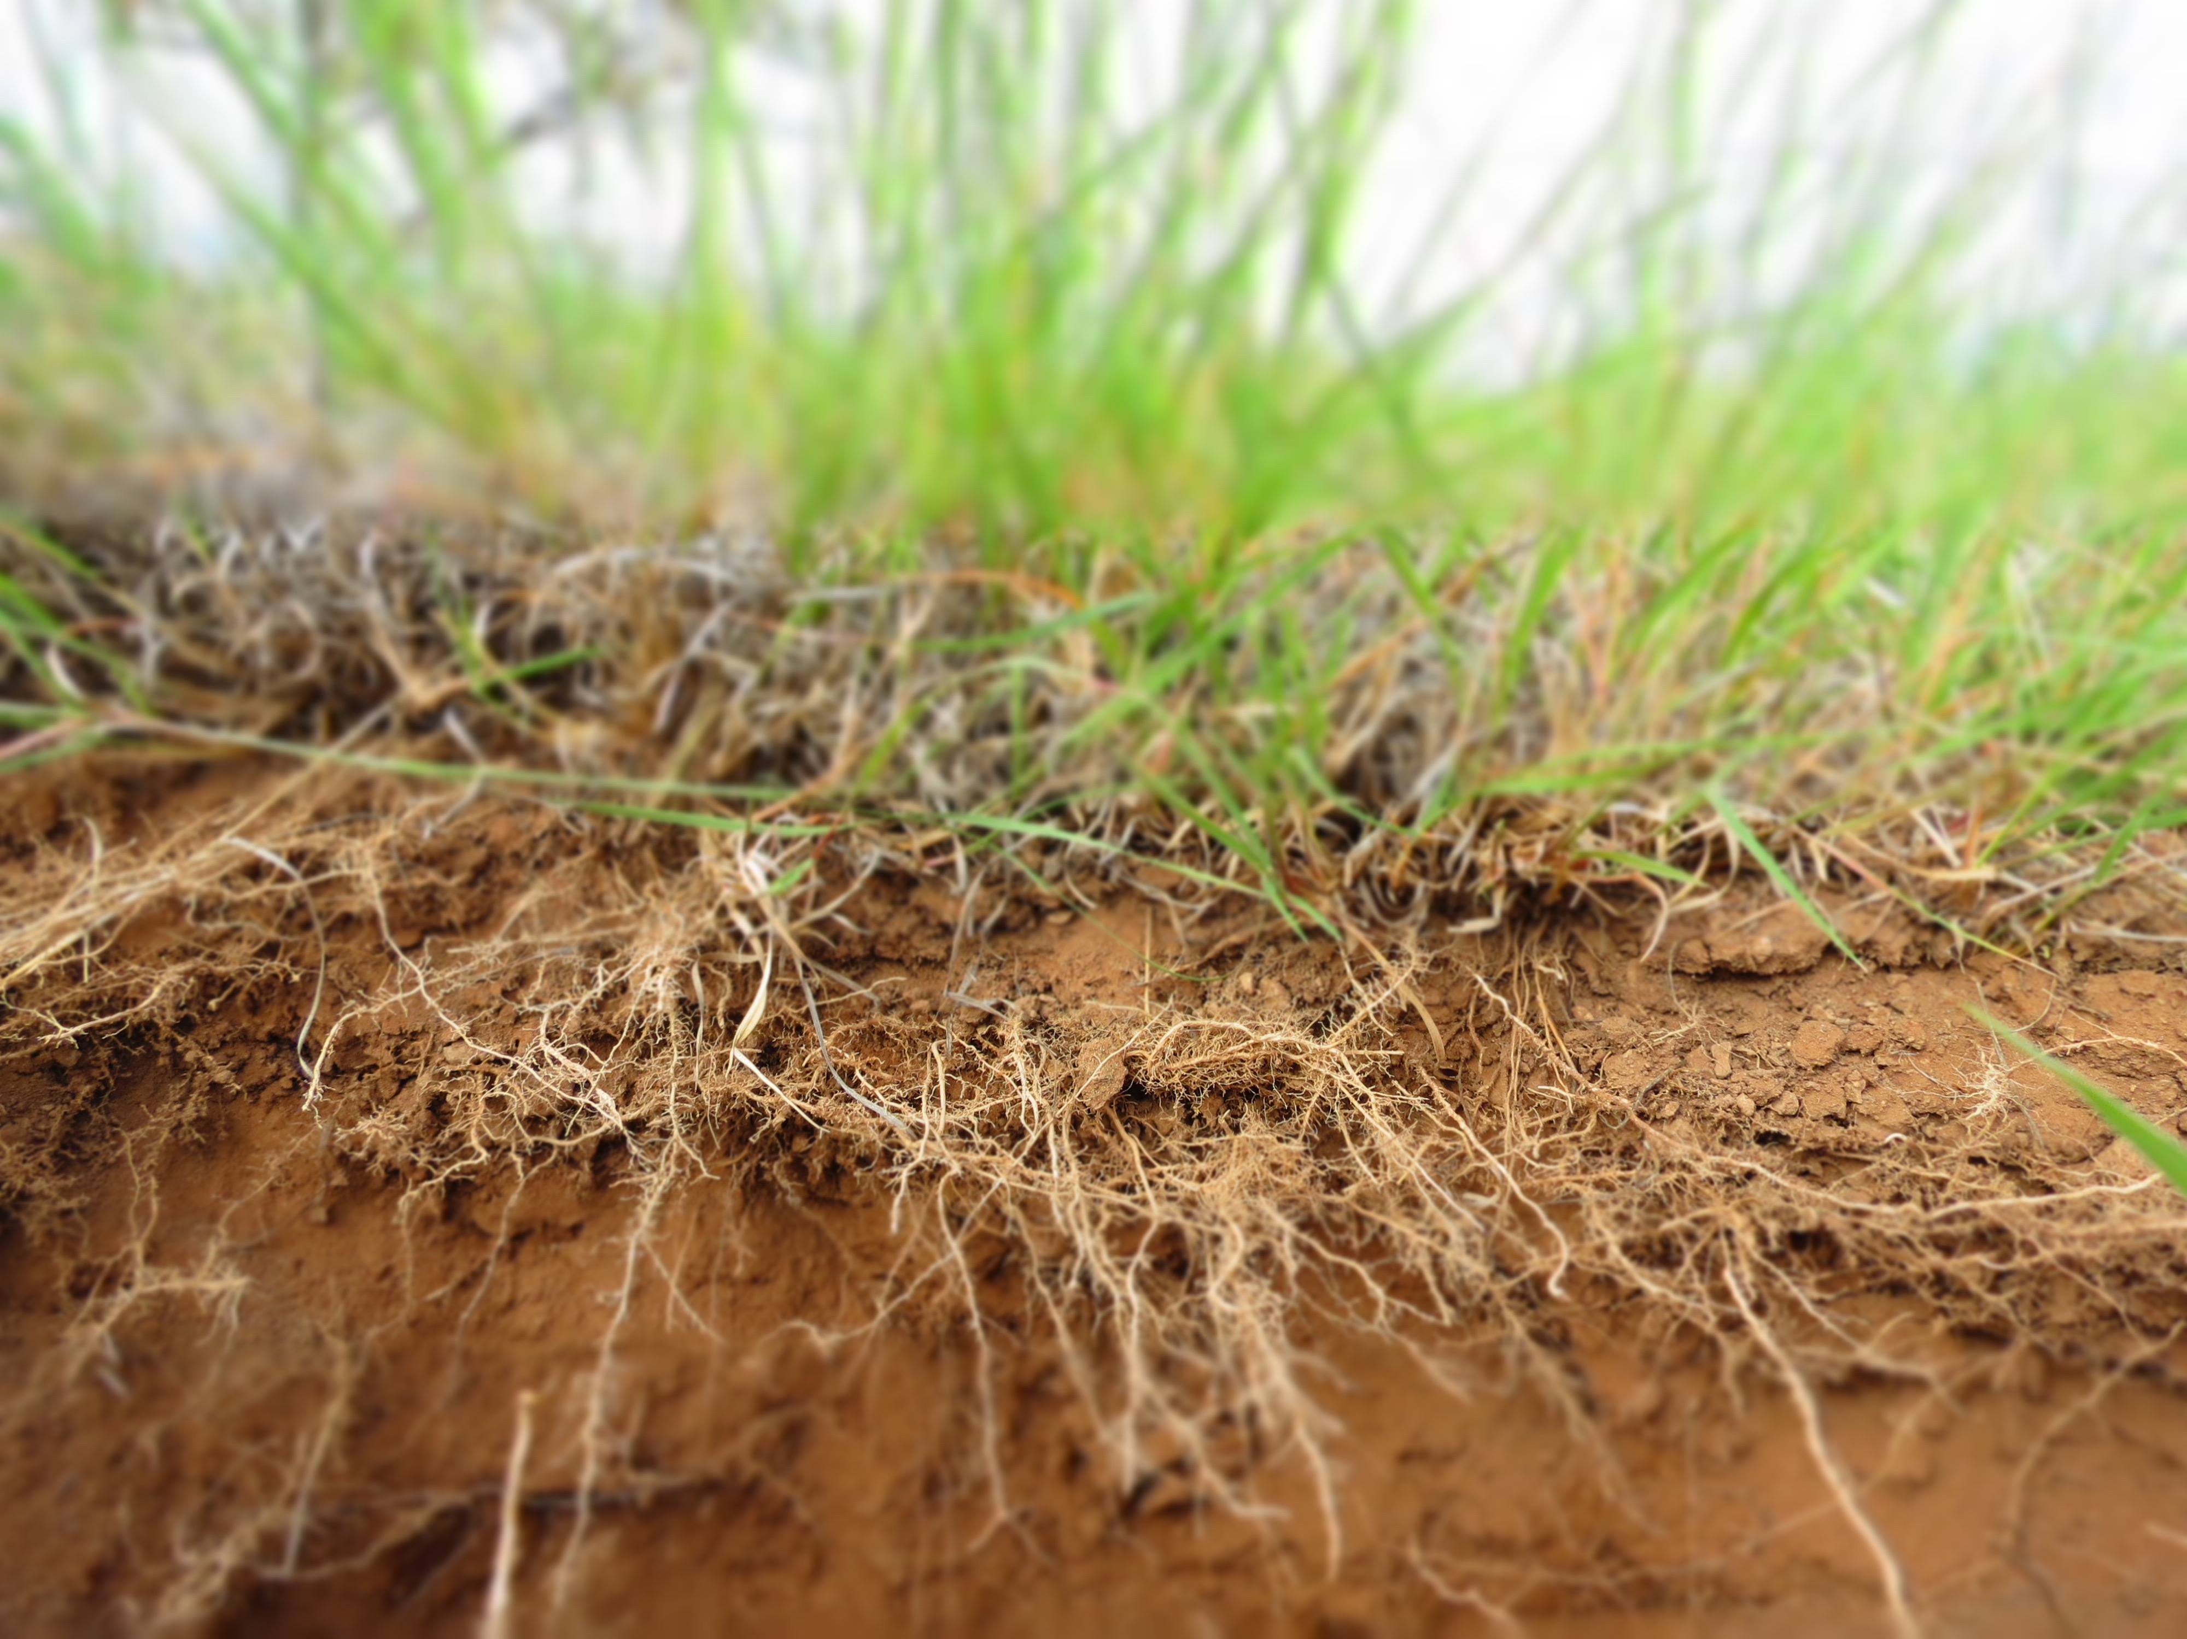
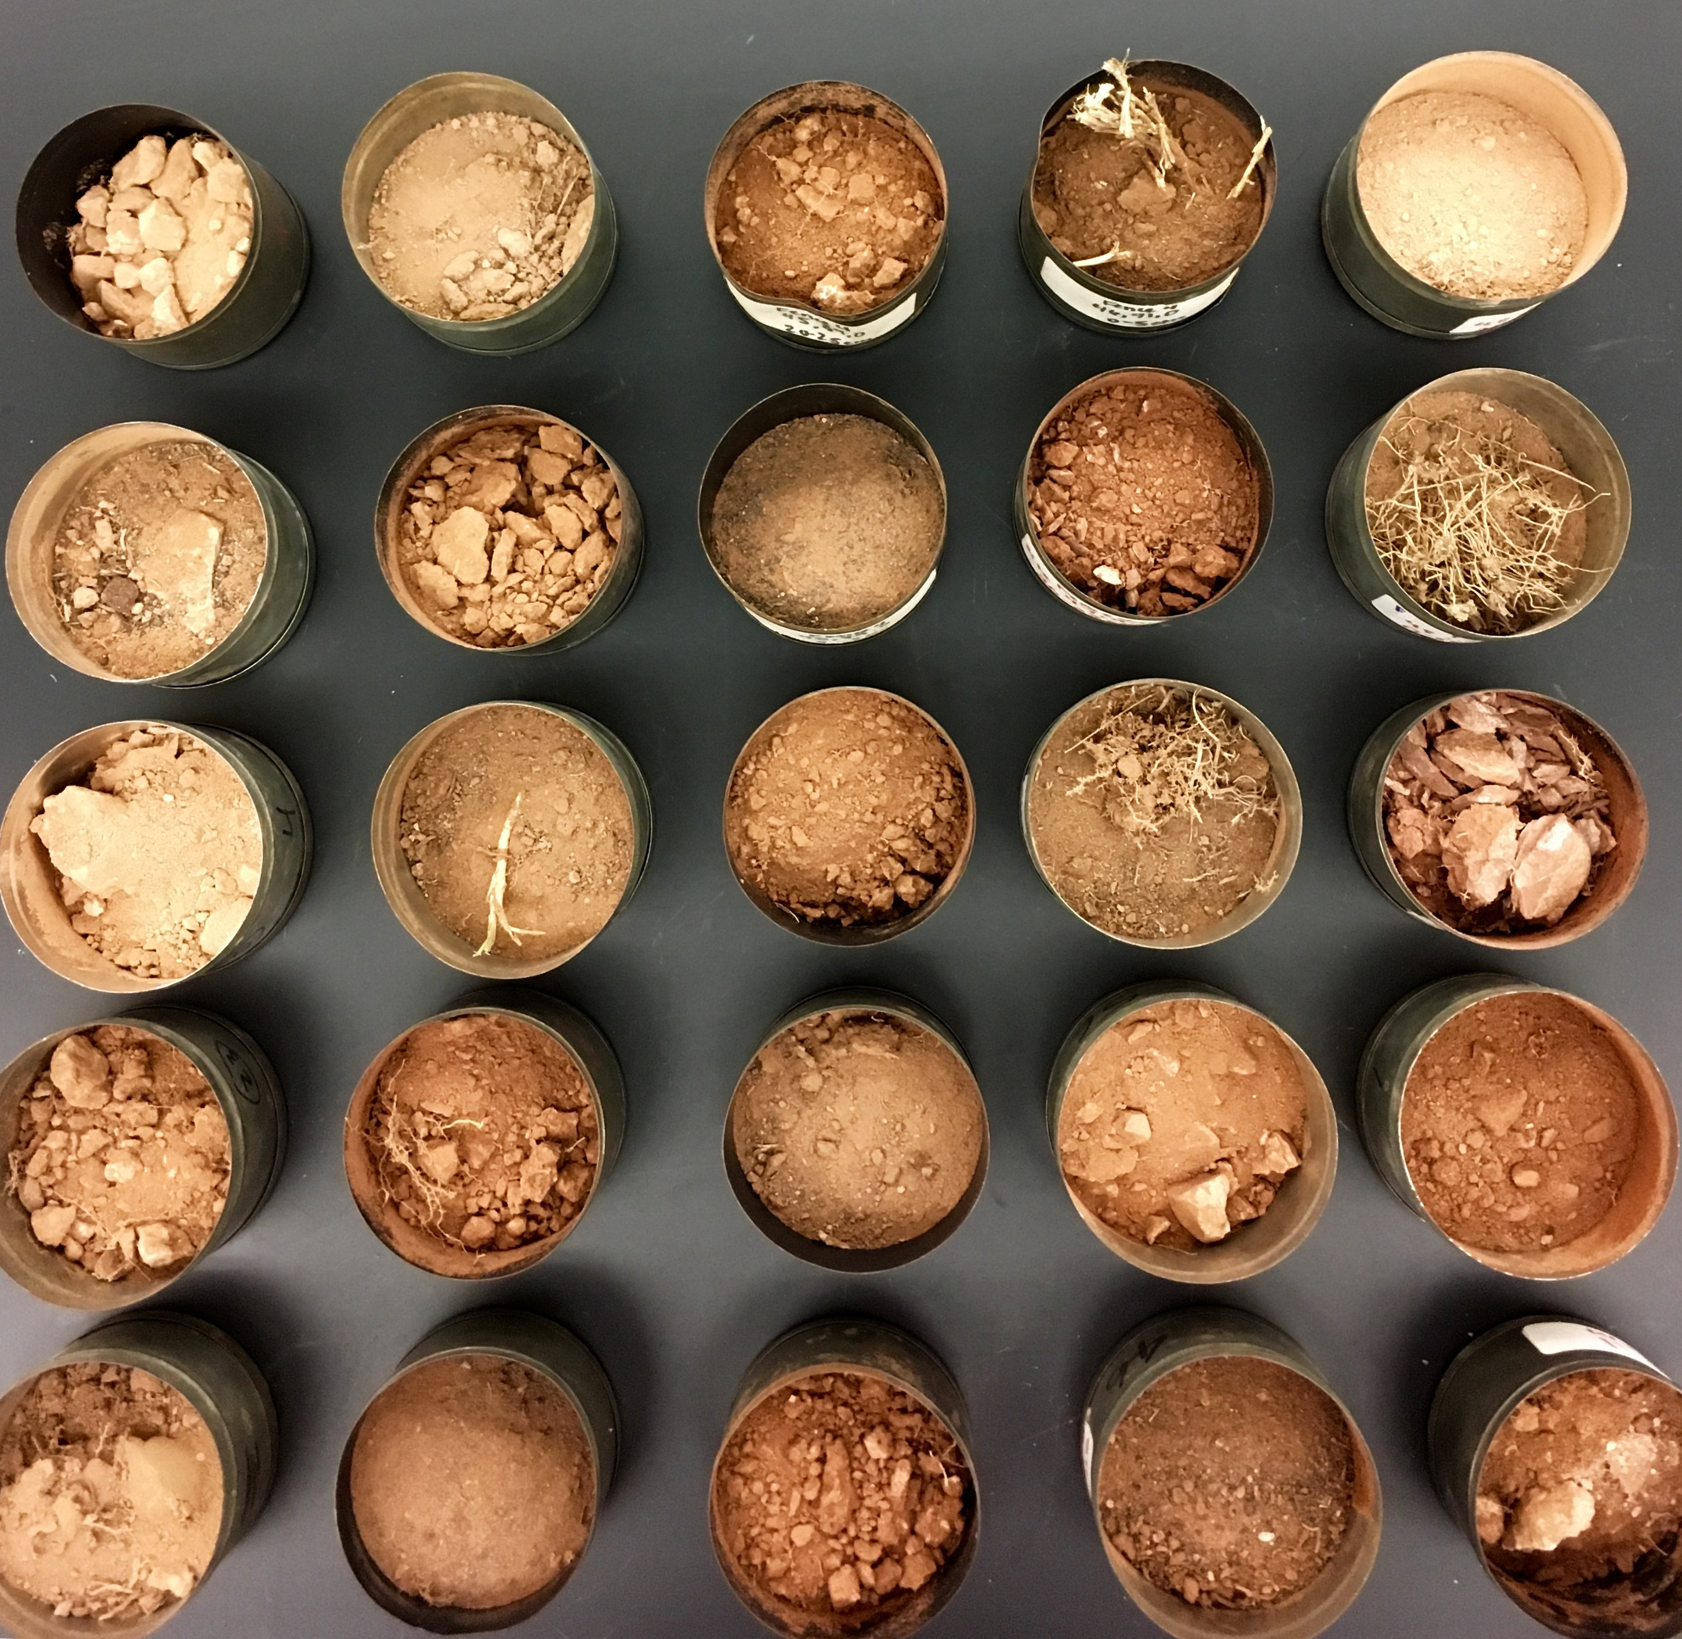
What did we learn?
Soil carbon is heavily dependent on where the sample was taken
That means that location, texture, and soil type have a greater influence on how much, and where, the soil stores carbon
Grazing likely has little to no impact on soil carbon

Slide 7
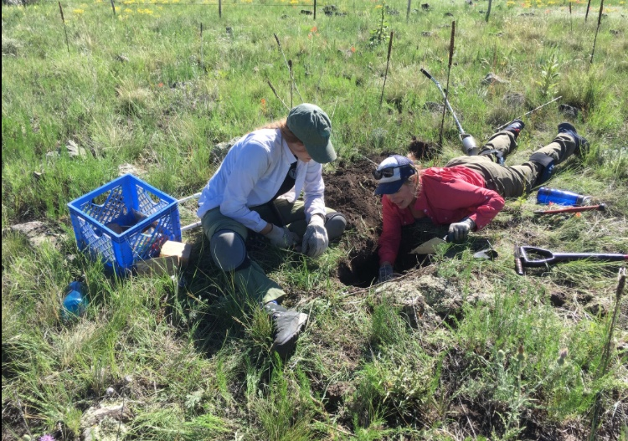
Acknowledgements and Questions?
Hooper Undergraduate Research Award provided by

